Slide 1
Animated slides – Please use Slide Show view option
2020-2022 Puget Sound VELMA Modeling Projects
– Linking Ecosystem Health and Human Health –
Bob McKane¹, Jonathan Halama¹, Allen Brookes¹,
Kevin Djang², Vivian Phan¹, Brad Barnhart³, Paul Pettus⁴
¹U.S. Environmental Protection Agency; ²Inoventure Inc; ³NCASI; ⁴Paul Pettus, LLC
Washington Department of Ecology Meetings
April 22 and May 12, 2020
Office of Research and Development
Center for Public Health and Environmental Assessment - Pacific Ecological Systems Division, Corvallis, OR
Notes:
I will begin with an overview of a collaborative project involving our ORD VELMA ecohydrology modeling team and Nisqually Community Forest members.

Slide 2
Presentation Sharing Policy
Please do not publicly share this presentation, which is being cleared through EPA’s peer-review process for non-public distribution
Disclaimer
The views expressed in this presentation are those of the author[s] and do not necessarily represent the views or policies of the U.S. Environmental Protection Agency
Office of Research and Development
Center for Public Health and Environmental Assessment - Pacific Ecological Systems Division, Corvallis, OR

Slide 3
Puget Sound Projects
VELMA Overview
Basin-Scale Nutrient Remediation
Urban Stormwater GI
R2R2R Community Benefits
Projects, 2020-2022 | EPA Program
A Puget Sound, whole-basin systems modeling framework for dynamically simulating biophysical interactions and transfers of water, nutrients and contaminants across terrestrial-marine boundaries. Short title: Basin-Scale Nutrient Remediation | Safe and Sustainable Waters Research Program SSWR 5.2.2
VELMA green infrastructure modeling for salmonid and orca recovery in Puget Sound. Short title: Urban Stormwater GI | Region 10 RARE program RARE 2188
Scaling localized urban green infrastructure practices to estimate reductions in stormwater contaminant loads across multiple watershed scales Short title: Urban Stormwater GI, with grant (2) | Safe and Sustainable Waters Research Program SSWR 10.1.1
Where to work? Development of remediation and restoration strategies to revitalize community health and well-being in contrasting urban-estuarine ecosystems Short title: R2R2R Community Benefits | Sustainable and Healthy Communities Research Program SHC 9.3.5
VELMA Modeling Projects in Puget Sound

Slide 4

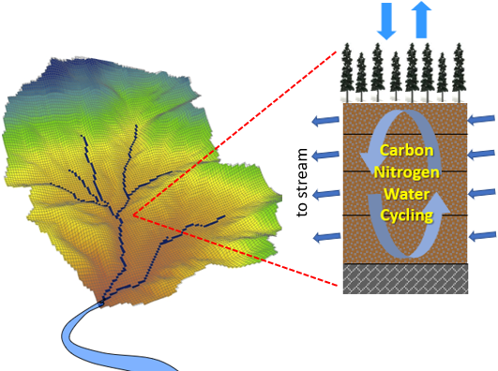
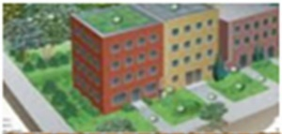
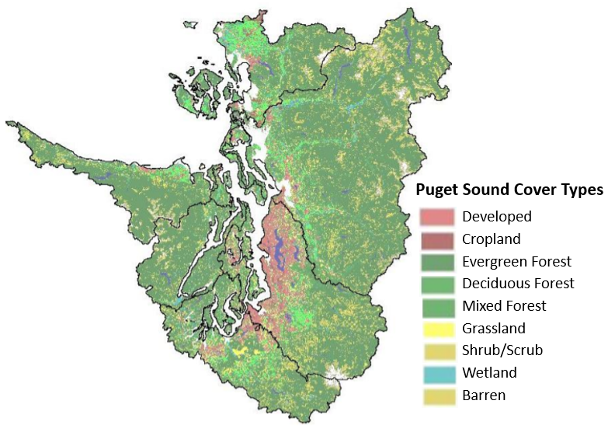
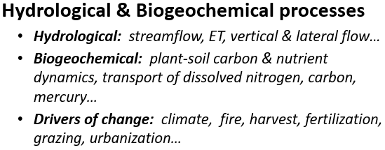
VELMA Visualizing Ecosystem Land Management Assessments
Puget Sound Projects
VELMA Overview
Basin-Scale Nutrient Remediation
Urban Stormwater GI
R2R2R Community Benefits
Mixed-Use Landscape Applications
Natural and Human Systems
VELMA is a spatially distributed, ecohydrological model that links a land surface hydrology model with a terrestrial biogeochemistry model for simulating the integrated responses of vegetation, soil, and water quality and quantity to interacting stressors
2 – 125 meters
NH₄, NO₃, DON, DOC, toxic chemicals
temperature
Ecohydrological Processes and Drivers
Hydrological: peak & low flows, ET, snow dynamics…
Biogeochemical: plant-soil C & N dynamics, fate & transport of dissolved nutrients & contaminants…
Drivers of change: climate, fire, harvest, grazing, nutrient and contaminant additions, irrigation, impervious surfaces, drains and pipes, green infrastructure…
Ecosystem Services Simulated
Clean water & air
Flood protection
Food & fiber production
Carbon sequestration / climate regulation
Fish & wildlife habitat → population models
Ecosystem services→ human health & well-being
Bolte, J. and Vache, K., 2010. Envisioning Puget Sound Alternative Futures. Oregon State University
http://envision.bioe.orst.edu/StudyAreas/PugetSound/PSNERP_Final_Report.pdf
See also: Hoghooghi et al. 2018 "Cumulative effects of low impact development on watershed hydrology in a mixed land-cover system." Water 10.8: 991.

Slide 5
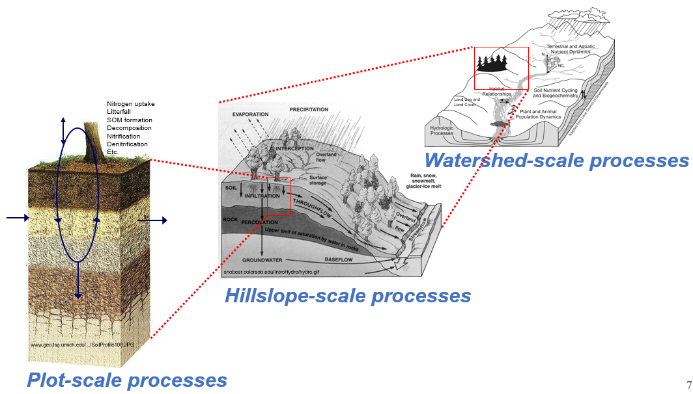
VELMA Visualizing Ecosystem Land Management Assessments
Puget Sound Projects
VELMA Overview
Basin-Scale Nutrient Remediation
Urban Stormwater GI
R2R2R Community Benefits
A main purpose of this multi-scale approach is to help LIOs and other local planners formulate effective habitat and watershed restoration decisions, and to visualize how effects of their decisions will propagate downstream with far reaching benefits and tradeoffs for terrestrial and marine ecosystem services.
Key Premise
Hydrological and biogeochemical processes interact across multiple scales
These interactions tightly regulate stream water quality and quantity, food and fiber production, habitat quality and other ecosystem services
A spatially distributed, ecohydrological model that links a land surface hydrology model with a terrestrial biogeochemistry model for simulating the integrated responses of vegetation, soil, and water quality and quantity to interacting stressors

Slide 6
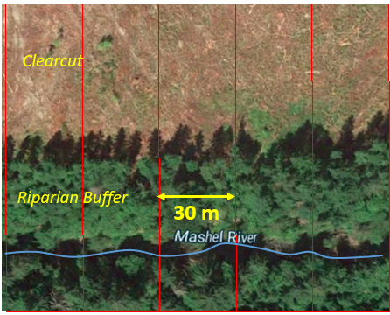
VELMA Visualizing Ecosystem Land Management Assessments
Puget Sound Projects
VELMA Overview
Basin-Scale Nutrient Remediation
Urban Stormwater GI
R2R2R Community Benefits
Grid size is important
Users select VELMA’s grid size
30-meter grids are generally well suited for simulating effects of land use on streamflow and water quality in forest and agricultural landscapes.
Example question:
Where and how wide or tall does a riparian buffer need to be to protect stream water quality?

Slide 7
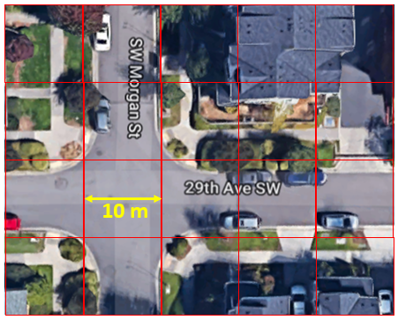
VELMA Visualizing Ecosystem Land Management Assessments
Puget Sound Projects
VELMA Overview
Basin-Scale Nutrient Remediation
Urban Stormwater GI
R2R2R Community Benefits
Grid size is important
Urban applications require smaller grids to capture effects of impervious surfaces, curbs, drains, pipes, rain gardens, green roofs, and other gray and green infrastructure.
Example question:
Where and what kind of green and gray infrastructure should stormwater managers use to reduce stormwater runoff and contaminant loads to streams and estuaries?
Such questions cannot be answered unambiguously using semi-distributed models (HSPF, SWAT…), in comparison to fully-distributed (grid-based) models such as VELMA.

Slide 8
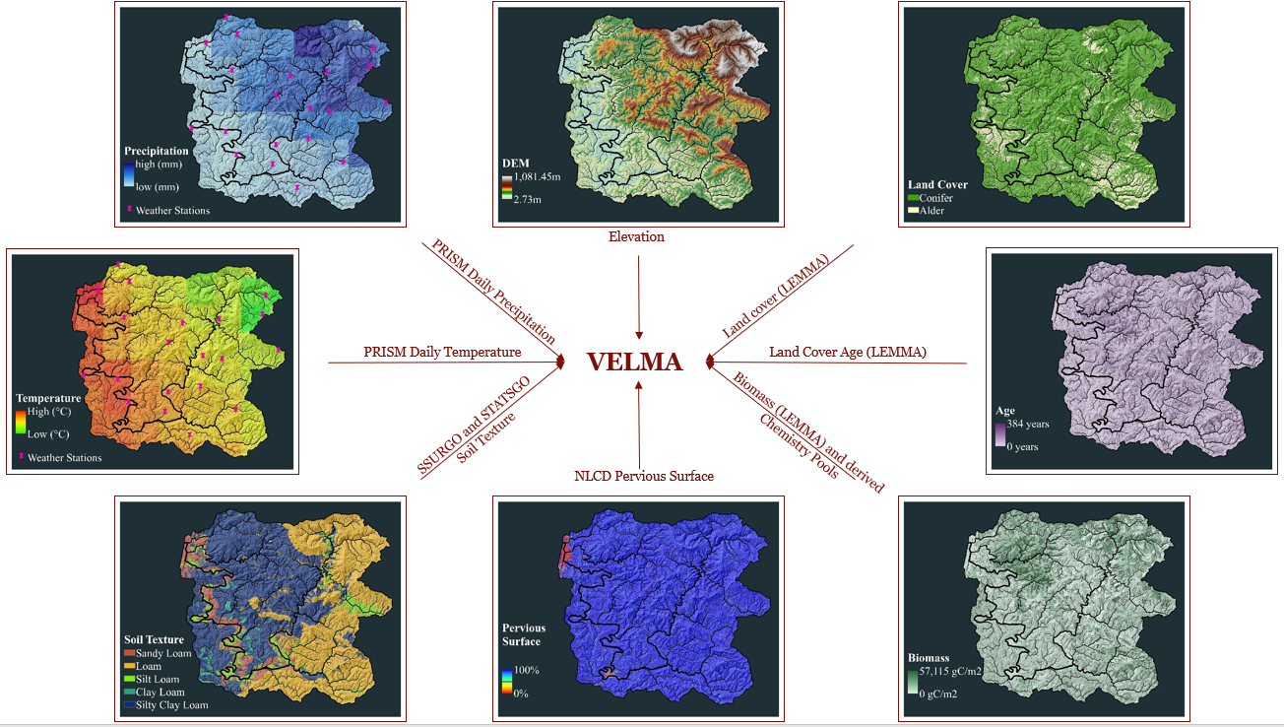
Puget Sound Projects
VELMA Overview
Basin-Scale Nutrient Remediation
Urban Stormwater GI
R2R2R Community Benefits
Publicly available data used to set up VELMA
Image: Courtney Zambory, Oregon Dept of Fish and Wildlife

Slide 9
Puget Sound Projects
VELMA Overview
Basin-Scale Nutrient Remediation
Urban Stormwater GI
R2R2R Community Benefits
VELMA’s Many Outputs
Instream Flow
Surface Runoff
Standing Water
Snow
Snow Depth
Snow Melt
Soil Moisture
PET
ET
Soil Temperature
Stream Temperature
Biomass Pool
agBiomass Pool
bgBiomass Pool
Biomass Leaf
Biomass AgStem
Biomass BgStem
Biomass Root
agLitter Pool
bgLitter Pool
Detritus Leaf
Detritus AgStem
Detritus BgStem
Detritus Root
Humus Pool
Humus
NH4 Pool
NO3 Pool
DON Pool
DOC Pool
NPP C
NPP N
Plant Uptake
CO2 Respiration
Surface NH4 Loss
NH4 Loss
Surface NO3 Loss
NO3 Loss
Surface DON Loss
DON Loss
Surface DOC Loss
DOC Loss
DIN Loss
N2O Denitrification
N2 Denitrification
NEP C
Image: Courtney Zambory, Oregon Dept of Fish and Wildlife

Slide 10
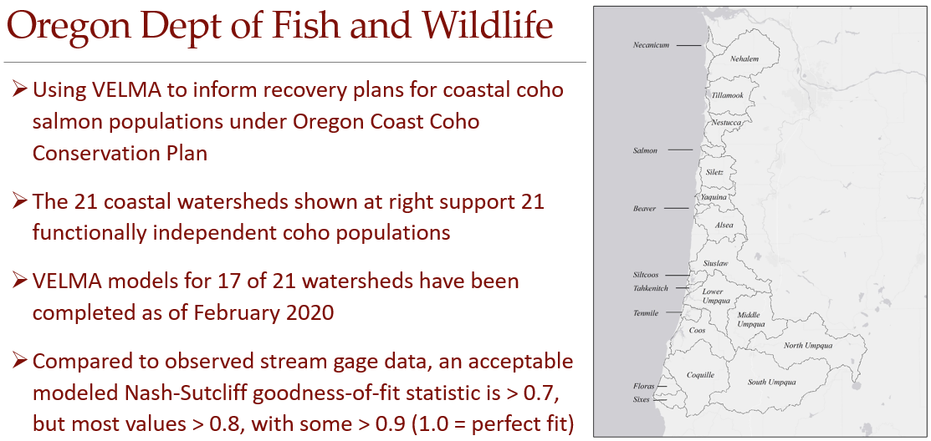

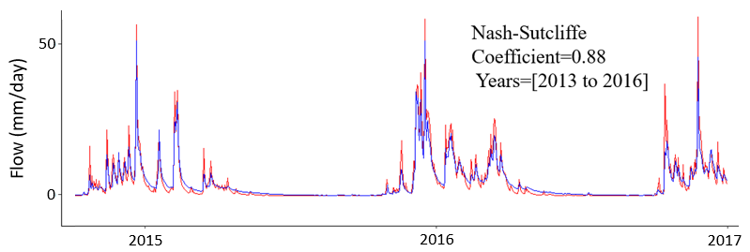
Puget Sound Projects
VELMA Overview
Basin-Scale Nutrient Remediation
Urban Stormwater GI
R2R2R Community Benefits
Portland
21 Coastal
Oregon
Watersheds
VELMA stream flow predictions reflect the interaction of hydrologic and biogeochemical processes across plot, hillslope and watershed scales, while accounting for spatial and temporal variations in climate, soils, vegetation, and land use.
VELMA uses parallel processing to speed up simulations and handle computational demands.
For example, the North Umpqua watershed (right inset) is 3,500 km² and contains about 5 million 30-meter VELMA cells, each requiring many hundreds of calculations per daily timestep → ~1 day/simulated year.
Modeled (red) vs. Observed Flow – Alsea Watershed (1,210 km²)
Courtney Zambory, ODFW

Slide 11
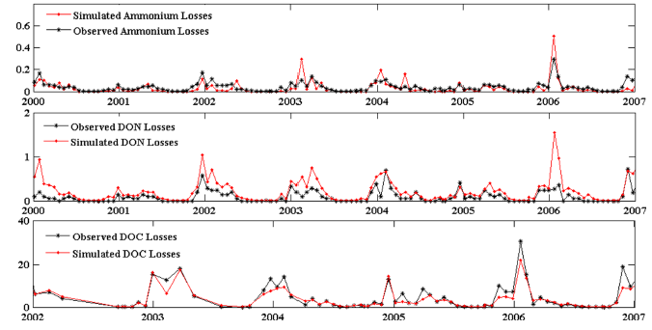
Puget Sound Projects
VELMA Overview
Basin-Scale Nutrient Remediation
Urban Stormwater GI
R2R2R Community Benefits
Stream nutrient loadings
NH₄ mg N m²
VELMA water quality predictions reflect the interaction of hydrologic and biogeochemical processes across plot, hillslope and watershed scales, while accounting for spatial and temporal variations in climate, soils, vegetation, and land use.
VELMA results at right show simulated (red dots) versus observed (black dots) NH₄ (mg N m²), DON (mg N m²), and DOC losses (mg C m²) to the stream after a 1975 clear-cut of a 450 year-old forest in Oregon.
DON mg N m²
DOC mg N m²
Abdelnour et al. 2013

Slide 12
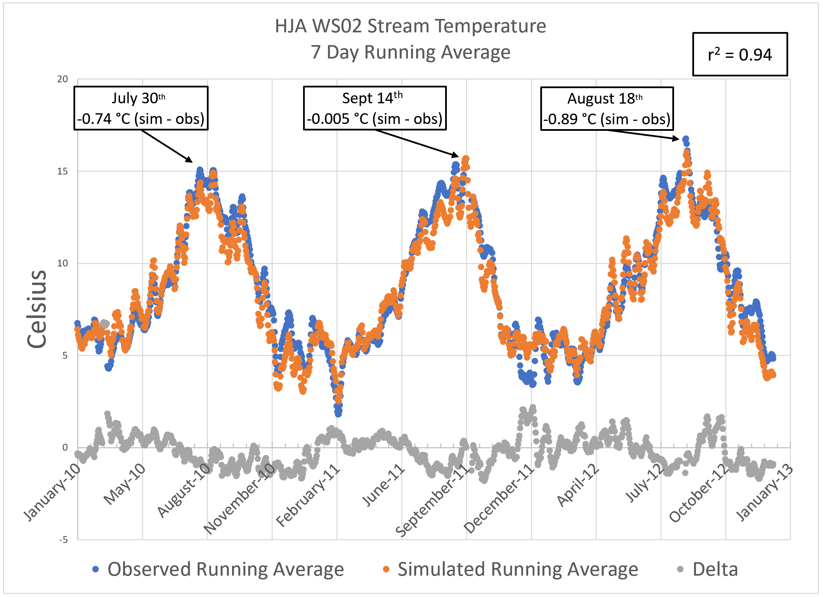
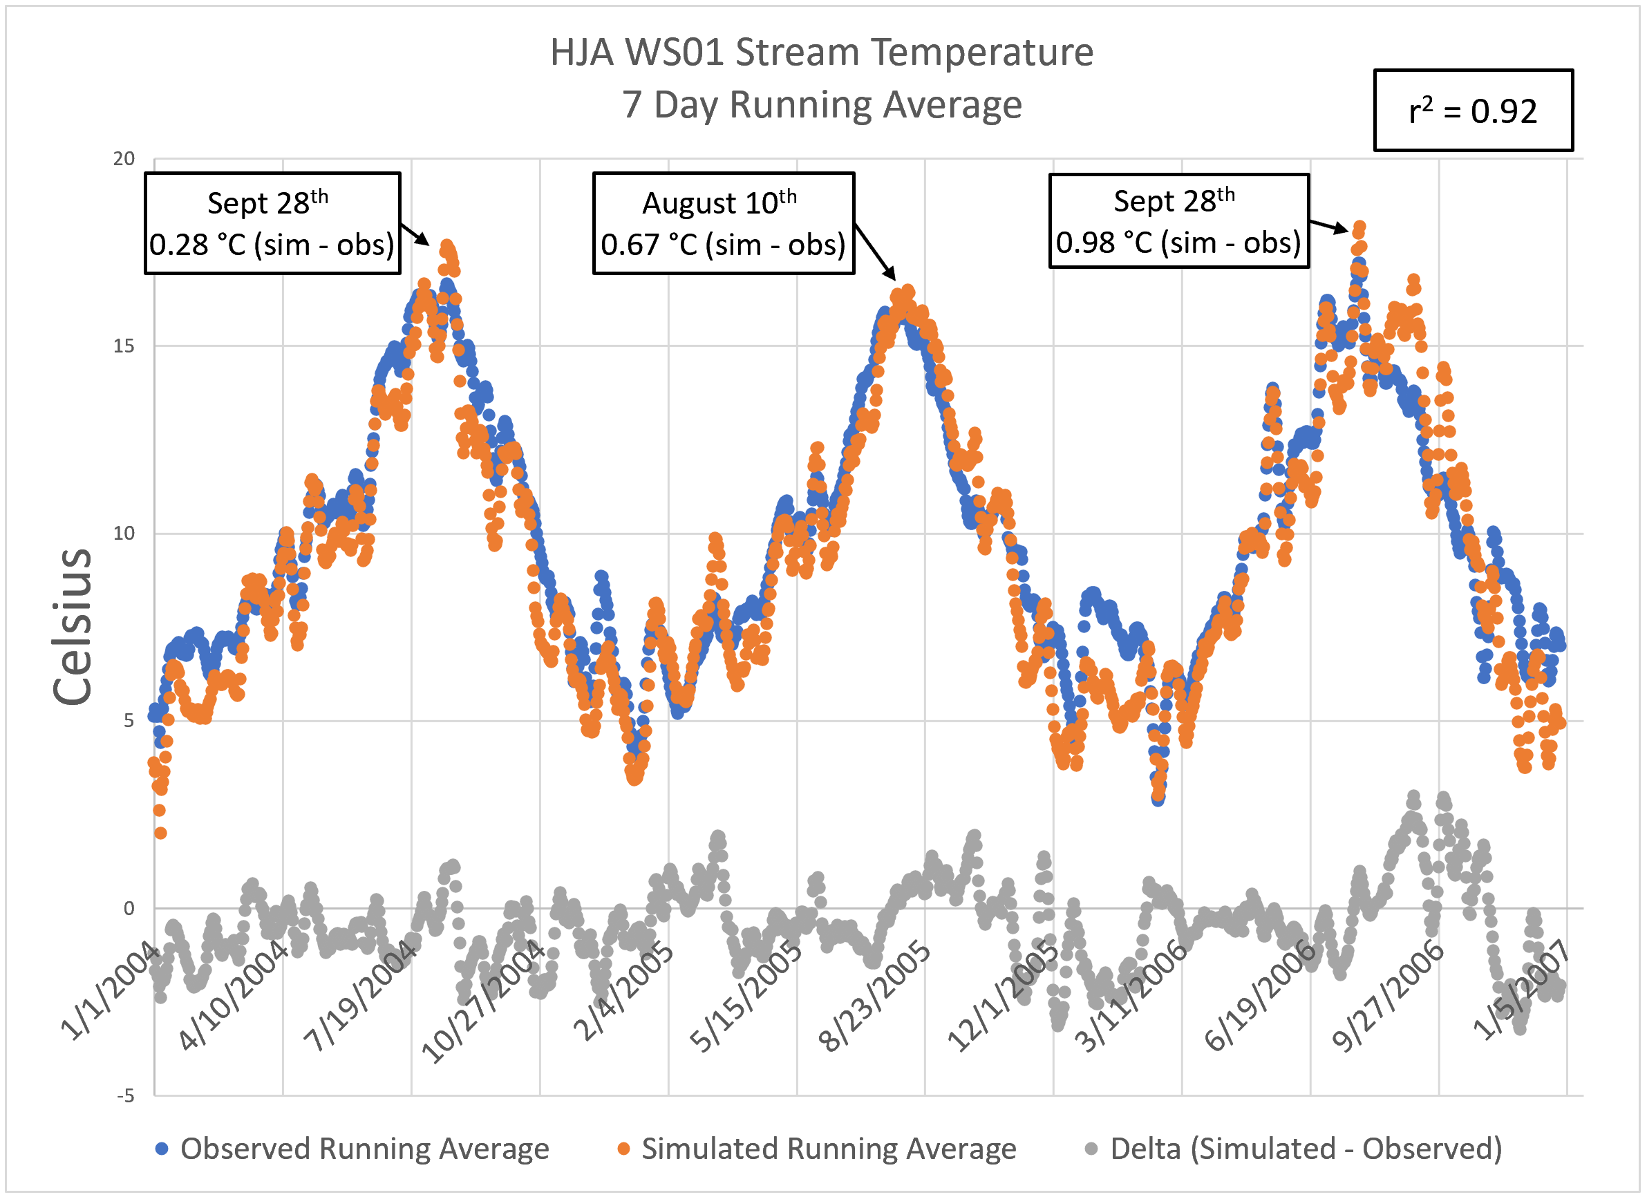

Puget Sound Projects
VELMA Overview
Basin-Scale Nutrient Remediation
Urban Stormwater GI
R2R2R Community Benefits
Stream Temperature
HJ Andrews Experimental Forest, Oregon
STREAM TEMPERATURE predictions by the coupled VELMA-Penumbra models accurately account for effects of riparian and upland vegetation cover and management on solar radiation (thermal loads) reaching surfaces of streams and upland soils containing groundwater flowing to streams.
Penumbra is a spatially-explicit solar radiation and object (vegetation and terrain) shade tool. Halama et al. 2018a and 2018b provide details.
When coupled, VELMA feeds Penumbra information on vegetation height or removal (fire, harvest, etc.), and surface and subsurface flow.
40 yr-old forest
450 yr-old forest
Images: Jonathan Halama, EPA/CPHEA/PESD

Slide 13
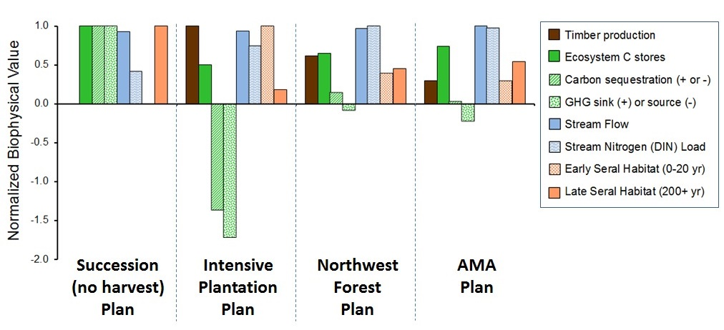
Puget Sound Projects
VELMA Overview
Basin-Scale Nutrient Remediation
Urban Stormwater GI
R2R2R Community Benefits
Ecosystem goods and services tradeoffs for alternative land use plans
VELMA ecosystem service and tradeoff predictions can help decision makers assess co-benefits and unintended consequences of different management options.
Modeled results at right show projected tradeoffs in the year 2200 when four forest management scenarios (Cissel et al. 1999) were applied to present-day landscape conditions in the 230 km² Blue River watershed in Oregon.
For each target ecosystem service – timber production, etc. (see legend) – simulated biophysical outputs (y-axis) across all four management scenarios are normalized with respect to the greatest simulated value for that ecosystem service.
McKane et al. in press

Slide 14
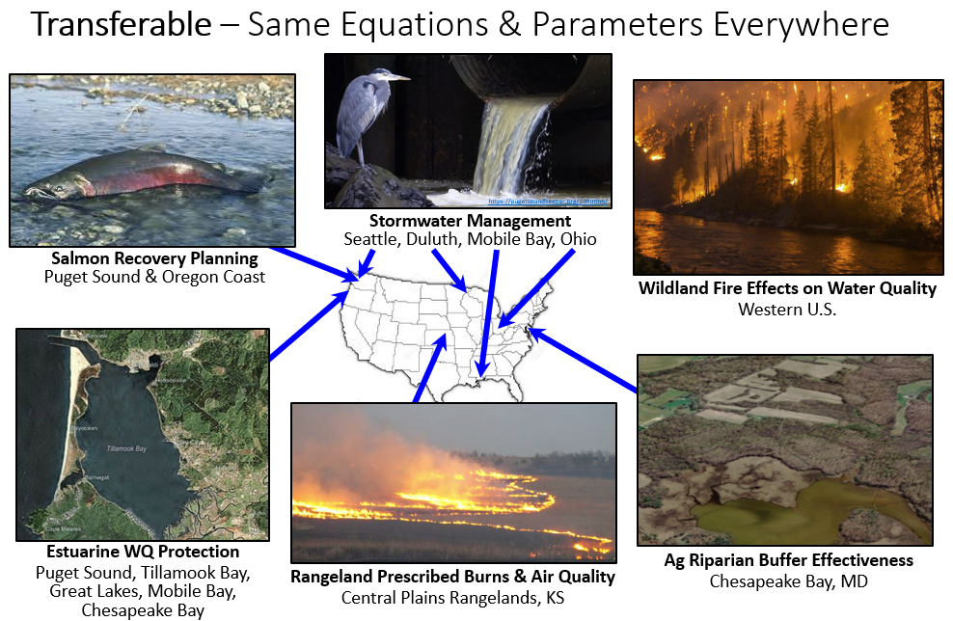
Puget Sound Projects
VELMA Overview
Basin-Scale Nutrient Remediation
Urban Stormwater GI
R2R2R Community Benefits

Slide 15
Puget Sound Projects
VELMA Overview
Basin-Scale Nutrient Remediation
Urban Stormwater GI
R2R2R Community Benefits
End
VELMA Overview
Begin
Basin-Scale Nutrient Remediation (SSWR Project 5.2.2)

Slide 16
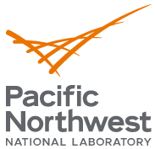
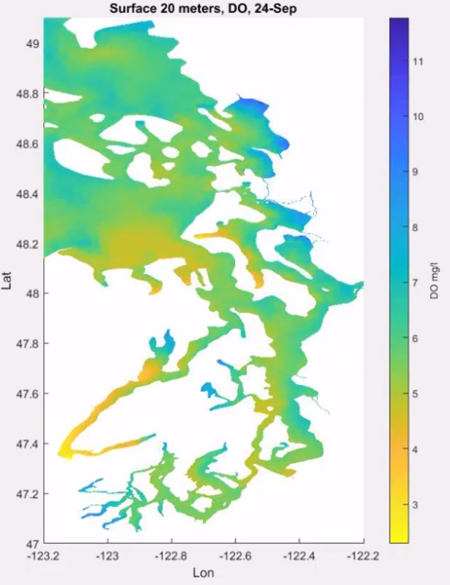
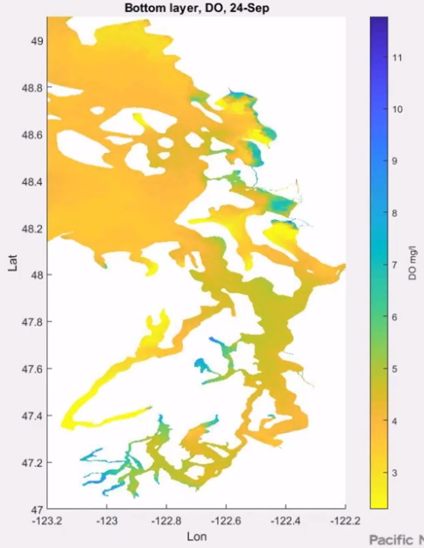
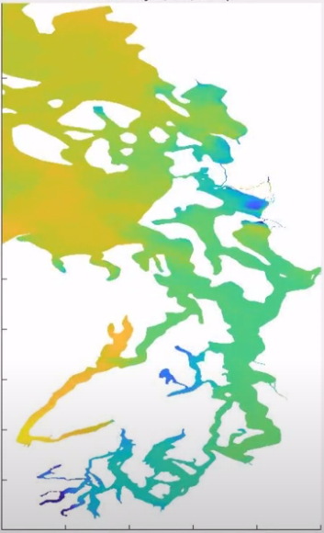
Puget Sound Projects
VELMA Overview
Basin-Scale Nutrient Remediation
Urban Stormwater GI
R2R2R Community Benefits
Modeled Dissolved Oxygen – Puget Sound
SSWR Project 5.2.2 (FY20-22)
Puget Sound Basin-Scale Nutrient Remediation
Salish Sea Model Results
Bottom layer, DO, April 5th
Bottom layer, DO, September 24th
Title: “A Puget Sound, whole-basin systems modeling framework for dynamically simulating transfers of water, nutrients and contaminants across terrestrial-marine boundaries, to help decision makers identify effective pollutant reduction strategies and estuarine recovery trajectories”
Problem: Driven mostly by increasing pollutant inputs from activities of a rapidly expanding human population, the Puget Sound National Estuary is experiencing rapid declines in marine species such as endangered salmon and killer whales, eelgrass and other marine food web biota sensitive to low dissolved oxygen, toxic chemicals and habitat loss.
San Juan Islands
San Juan Islands
Dissolved Oxygen (mg/L
Dissolved Oxygen (mg/L
Seattle
Seattle
Seattle
Olympia
Olympia
Olympia
https://www.arcgis.com/apps/MapSeries/index.html?appid=907dd54271f44aa0b1f08efd7efc4e30

Slide 17
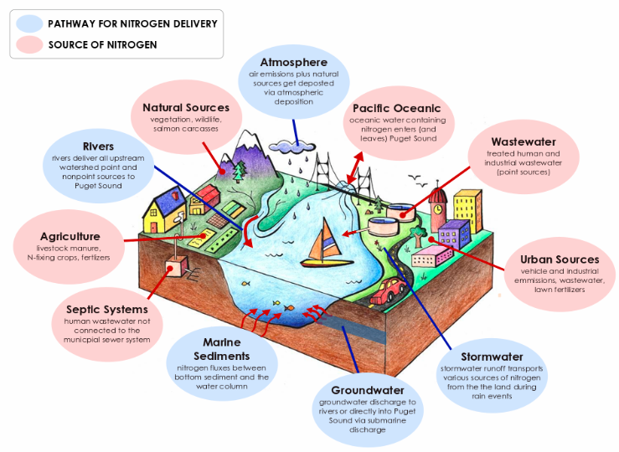

Puget Sound Projects
VELMA Overview
Basin-Scale Nutrient Remediation
Urban Stormwater GI
R2R2R Community Benefits
SSWR Project 5.2.2
Puget Sound Basin-Scale Nutrient Remediation
Puget Sound Nitrogen Sources and Transfers
Challenges
Nutrients and other pollutants entering Puget Sound are steadily increasing as urban and rural land uses intensify.
Excess nitrogen loads are especially problematic for Puget Sound marine life, contributing to algal blooms, low dissolved oxygen (hypoxia) and consequent “dead zones“.
Nitrogen inputs to Puget Sound have many sources and modes of transfer from land to estuary (see inset). Local, state, federal and private stakeholders have committed significant resources to quantifying these terrestrial- marine sources and transfers.
A major challenge will be to synthesize the enormous amounts of empirical data to support predictive assessments of terrestrial and marine nutrient fate and transport.
https://www.arcgis.com/apps/MapSeries/index.html?appid=907dd54271f44aa0b1f08efd7efc4e30

Slide 18
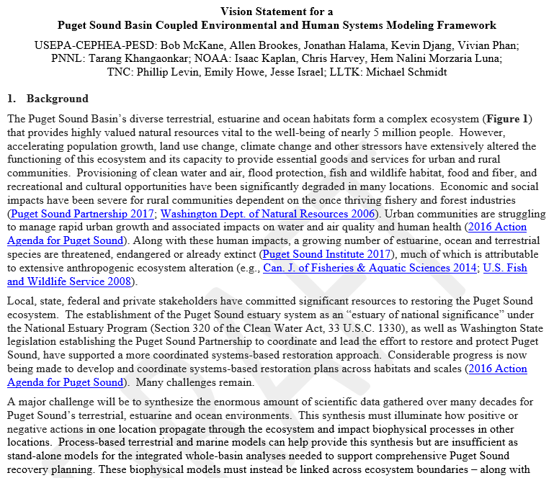
Puget Sound Projects
VELMA Overview
Basin-Scale Nutrient Remediation
Urban Stormwater GI
R2R2R Community Benefits
SSWR Project 5.2.2
Puget Sound Basin-Scale Nutrient Remediation
Modeling Approach
Puget Sound Systems Modeling Framework
To help inform development of nutrient remediation strategies, this project is establishing a whole-basin, systems modeling framework that dynamically simulates biophysical interactions and transfers of water, nitrogen and other pollutants across Puget Sound terrestrial-marine boundaries.
This integrated framework will include a terrestrial ecohydrological model (ORD’s VELMA model); an ocean circulation and biogeochemistry model (the Pacific Northwest National Laboratory’s Salish Sea Model); and an ocean food web model (NOAA’s Atlantis model).
The existing stand-alone Puget Sound applications of these process-based models are being coupled to simulate local to basin-scale nutrient fate and transport (click right pane to see p. 1 of draft vision statement).
The framework will be applied in collaboration with local, state, tribal and federal decision makers to help them assess and prioritize nutrient reduction strategies for accelerating Puget Sound marine ecosystem recovery trajectories.
VELMA Model
Terrestrial
Hydrology
Biogeochemistry
Fish and Wildlife*
https://www.epa.gov/water-research/visualizing-ecosystem-land-management-assessments-velma-model-20
*with other models
Salish Sea Model
Marine
Ocean circulation
Biogeochemistry
Atlantis Model
Marine
Diet
Movement
Mortality factors
https://ecology.wa.gov/Research-Data/Data-resources/Models-spreadsheets/Modeling-the-environment/Salish-Sea-modeling
https://www.nwfsc.noaa.gov/research/divisions/cb/documents/atlantis_ecosystem_model.pdf

Slide 19
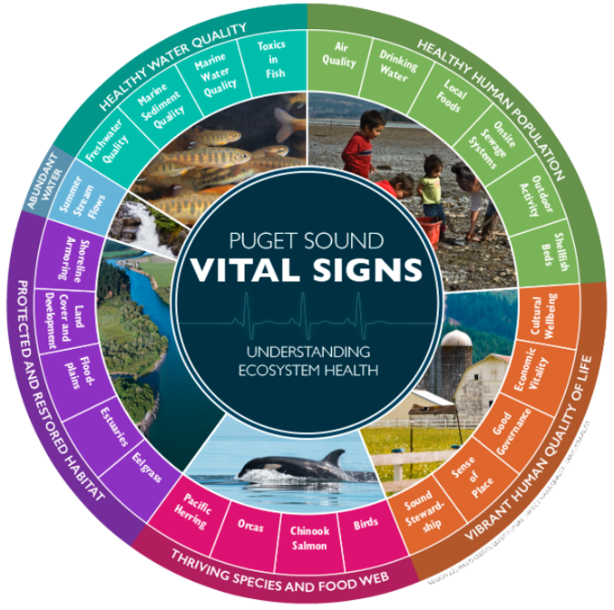
Puget Sound Projects
VELMA Overview
Basin-Scale Nutrient Remediation
Urban Stormwater GI
R2R2R Community Benefits
SSWR Project 5.2.2
Puget Sound Basin-Scale Nutrient Remediation
Context
Modeled nutrient reduction strategies will focus on benefits and tradeoffs for well-monitored terrestrial and marine endpoints of interest, per the Puget Sound Partnership’s 25 designated Puget Sound Vital Signs (https://www.psp.wa.gov/vitalsigns/)
Puget Sound Vital Signs are measures of terrestrial-marine ecosystem health that guide the assessment of progress toward Puget Sound recovery goals.
Each of 6 general Puget Sound recovery goals (outer ring at right) address at least one of 25 Vital Sign indicators (inner ring), including water quality and quantity, species and food webs, habitat, and human health and quality of life.
Initial applications of the EPA/PNNL/NOAA Puget Sound integrated model ensemble – VELMA-Salish Sea Model-Atlantis – will target the terrestrial and marine water quality and Chinook salmon recovery Vital Signs, as summarized in the next slide.
https://www.psp.wa.gov/evaluating-vital-signs.php

Slide 20

Puget Sound Projects
VELMA Overview
Basin-Scale Nutrient Remediation
Urban Stormwater GI
R2R2R Community Benefits
Puget Sound Recovery Goals & Vital Signs addressed by the Salish Sea, Atlantis and VELMA models, and by the Integrated Model Ensemble
SSWR Project 5.2.2
Puget Sound Basin-Scale Nutrient Remediation
Image: Tessa Francis, PSI
Recovery
Goal
VELMA
watershed
processes
Proof of Concept Project
Vital Sign
Salish Sea marine hydrodynamics
Atlantis
food
web
Near-term Modeling Goals
Individually, the EPA, PNNL and NOAA models – VELMA, Salish Sea and Atlantis – address different subsets of the Puget Sound Partnership’s Recovery Goals and Vital Signs, as shown at right.
When integrated, the full model ensemble can potentially support all 6 recovery goals and all 25 Vital Signs, in some cases with additional models(*).
For an initial proof-of-concept application (far right column in table), the integrated Puget Sound model ensemble – VELMA/Salish Sea Model/Atlantis – will target 9 Vital Signs across all 6 Recovery Goals.
Primary Vital Signs include freshwater quality and quantity (VELMA) and consequences for marine water quality (nitrogen) recovery trajectories (Salish Sea Model) and recovery of endangered Chinook salmon (Atlantis).
Σ 9

Slide 21
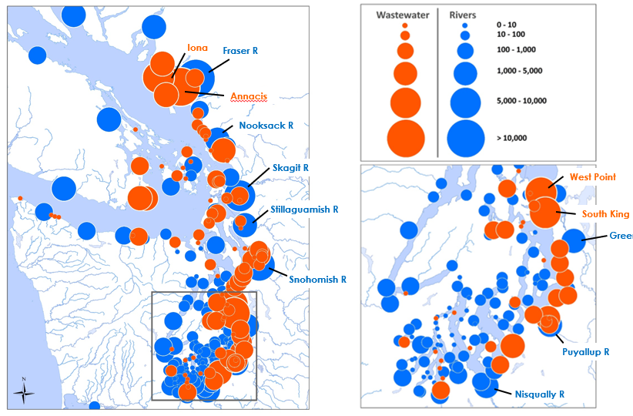
Terrestrial Inorganic Nitrogen Loads (kg/day) Entering Puget Sound, 1997-2017 Annual Average
Puget Sound Projects
VELMA Overview
Basin-Scale Nutrient Remediation
Urban Stormwater GI
R2R2R Community Benefits
SSWR Project 5.2.2
Puget Sound Basin-Scale Nutrient Remediation
Methods – Nitrogen Source Targets, Part 1
There are two main terrestrial inputs of nitrogen to Puget Sound:
Wastewater treatment plant (WWTP) effluent discharging directly into Puget Sound as marine outfalls from coastal communities.
Rivers and streams delivering sources from the watersheds they drain.
Nitrogen loads from watersheds (#2) include:
Humans: upstream WWTPs, septic systems, agriculture, atmospheric N deposition…
Natural sources: N-fixing vegetation (red alder) and wildlife.
VELMA will account for these watershed point and nonpoint sources of nitrogen.
The Salish Sea Model will account for WWTP marine outfalls (#1).
Wastewater
Rivers

Slide 22
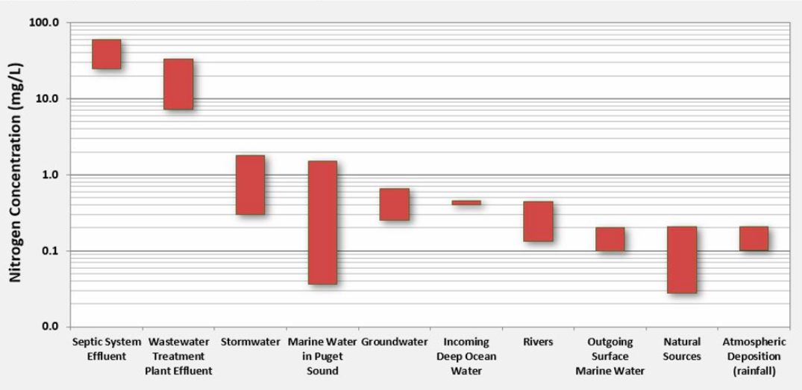

Puget Sound Projects
VELMA Overview
Basin-Scale Nutrient Remediation
Urban Stormwater GI
R2R2R Community Benefits
SSWR Project 5.2.2
Puget Sound Basin-Scale Nutrient Remediation
Puget Sound Point and Nonpoint Nitrogen Sources
https://www.arcgis.com/apps/MapSeries/index.html?appid=907dd54271f44aa0b1f08efd7efc4e30
Methods – Nitrogen Source Targets, Part 2
VELMA is designed to simulate fate and transport of the checked point and nonpoint nitrogen sources shown at right.
In addition to these, VELMA will need to account for fertilizer applications for agriculture, forestry, urban and other land uses.
VELMA allows users to isolate the contributions of different nitrogen sources to total nitrogen loads, spatial and temporal process-level controls on transport, and effectiveness of green and gray infrastructure for reducing nitrogen loads to streams, rivers and estuary.
= Nitrogen sources VELMA can model

Slide 23
Puget Sound Projects
VELMA Overview
Basin-Scale Nutrient Remediation
Urban Stormwater GI
R2R2R Community Benefits
SSWR Project 5.2.2
Puget Sound Basin-Scale Nutrient Remediation
Nitrogen remediation scenarios – Key questions:
For treated sewage, to what extent can WWTP upgrades for inland communities reduce N loads to freshwater streams? How will those upgrades translate to reduced N loads to Puget Sound?
For onsite sewage systems, to what extent can onsite upgrades reduce N loads to freshwater streams? How will those upgrades translate to improvements in terrestrial and marine water quality?
For poorly managed rural and urban land use practices, to what extent can reductions in nutrient fertilization and increases in green infrastructure (riparian buffers, rain gardens, bioswales, engineered wetlands, etc.) reduce terrestrial nitrogen loads?
For natural nitrogen sources, to what extent can riparian management options reduce biological inputs of N to streams? Options considered will include riparian cover type conversion of N-fixing alder with coniferous and/or non-N-fixing hardwood species capable of producing larger amounts of fine and coarse woody debris (carbon source) to enhance riparian and instream denitrification rates.
Scenarios – Nitrogen Remediation
As noted in the previous slides, primary terrestrial sources of nutrients in Puget Sound include
Treated sewage (WWTP)
Onsite sewage systems (septic)
Poorly managed land use practices, including over-application of fertilizers
Natural sources (alder, especially)
VELMA scenarios will be designed to address specific questions concerning these nitrogen sources, as discussed at right.
VELMA scenario-based terrestrial N loads at the terrestrial-marine boundary will be used as input for the Salish Sea Model
Current Salish Sea Model applications for marine nutrient assessments are described here

Slide 24
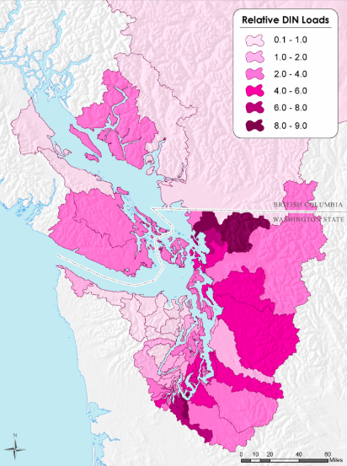
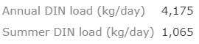
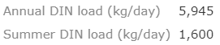
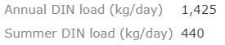
Puget Sound Projects
VELMA Overview
Basin-Scale Nutrient Remediation
Urban Stormwater GI
R2R2R Community Benefits
Prioritizing initial subbasin N load VELMA simulations
SSWR Project 5.2.2
Puget Sound Basin-Scale Nutrient Remediation
“River loads contribute the second largest local input of inorganic nitrogen to Puget Sound (after wastewater loading). There are about 13 major rivers that discharge to Puget Sound.”
https://www.arcgis.com/apps/MapSeries/index.html?appid=907dd54271f44aa0b1f08efd7efc4e30
Methods – Subbasin VELMA Demonstrations
Initial proof-of-concept VELMA applications will focus on a subset of Puget Sound sub-basins.
The three sub-basins shown at right were selected because they represent a wide range of nitrogen sources and loadings present in Puget Sound.
VELMA applications for each sub-basin will address nitrogen fate and transport for the sources described in the previous slide.
This modeling effort will rely on published and publicly available datasets gathered by collaborating partners
Nooksack River N Loads
- Main sources: ag, CAFO, N dep
Snohomish River N Loads
- Main sources: ag, urban, alder
Nisqually River N Loads
- Main sources: septic, alder
Source: Mohamedali et al., 2011

Slide 25
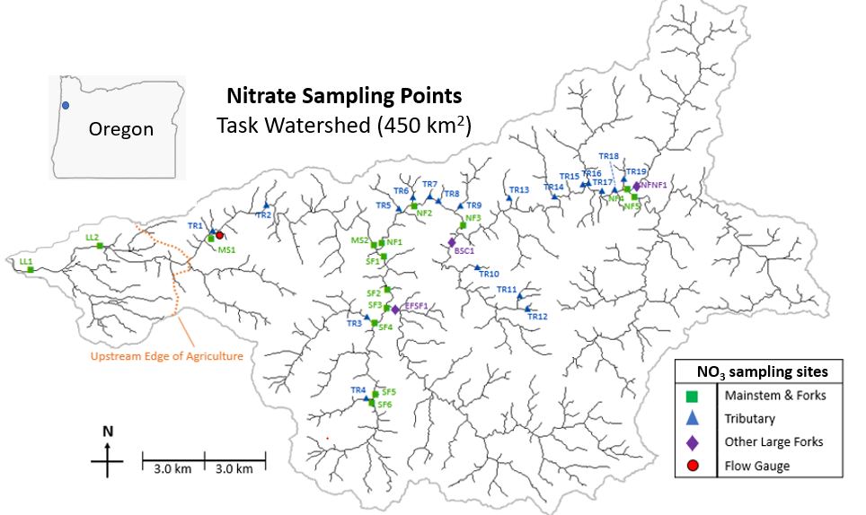
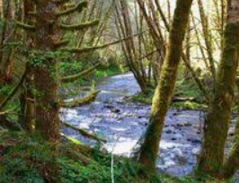
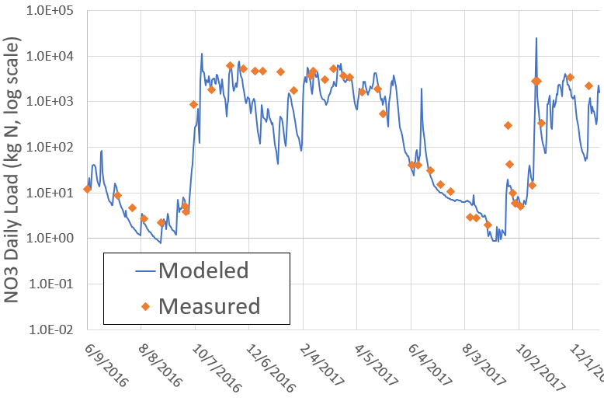
Puget Sound Projects
VELMA Overview
Basin-Scale Nutrient Remediation
Urban Stormwater GI
R2R2R Community Benefits
SSWR Project 5.2.2
Puget Sound Basin-Scale Nutrient Remediation
Trask River Watershed (450 km²)
Stream Nitrate Sampling Points
Methods – Modeling Natural N Sources
Red alder (Alnus rubra) is a nitrogen-fixing broadleaf tree common to moist riparian habitats and recently burned or harvested areas. Red alder comprises about 60 percent of the total hardwood volume in the Pacific Northwest.
Root systems of well-stocked alder stands can fix 100 kg N ha⁻¹ y⁻¹ or more. A portion of this fixed nitrogen is converted to inorganic nitrogen – ammonium (NH₄), and to the highly mobile form, nitrate (NO₃).
VELMA simulates N cycling in soils and plants, including N fixation, litterfall, ammonification, nitrification, denitrification, and hydrologic transport within hillslopes to streams.
VELMA has been used to accurately represent these processes in Oregon Coast Range watersheds, as shown at right (Marois in prep), and in the next slide (McKane et al. in prep).
Red alder along Trask River
VELMA nitrate results for the Trask River generated using publicly available data described in the VELMA Overview section (includes alder spatial coverage)
Measured stream nitrate data are based on synoptic stream sampling protocols for the dates shown
Source: Darryl Marois, in preparation – Do not cite

Slide 26
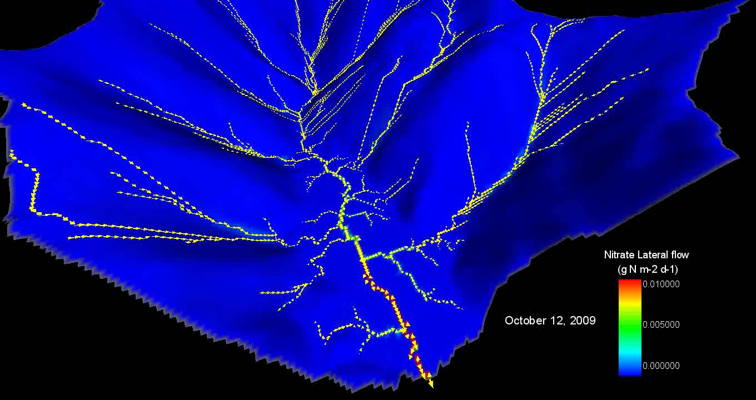
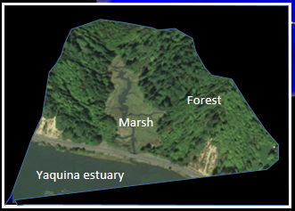
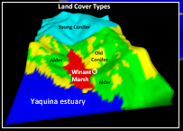
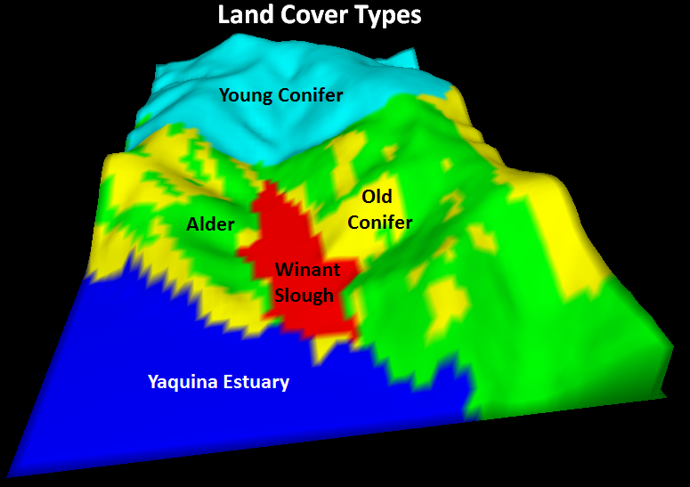
Puget Sound Projects
VELMA Overview
Basin-Scale Nutrient Remediation
Urban Stormwater GI
R2R2R Community Benefits
VELMA animation: upland sources & flow paths by which nitrate is flushed to an Oregon salt marsh
- Nitrate flux arrow size and background color indicate direction and amount of nitrate flushed per day -
Old Conifer
Alder
← Newport, OR
VELMA SUMMARY
October 18 overtopping high tide adds N-rich seawater to marsh.
Fall rains pick up October 27, mobilizing the alder soil nitrate pool that built up during dry summer months.
Soil column fully saturates after November 7, accelerating nitrate flushing.
A small patch of old Douglas fir just below the alder helps buffer the nitrate hotspot at the marsh edge.
Land Cover Types
Hotspot
Upland-Marsh Boundary
0.010
0.008
0.000
Marsh
Marsh
Alder
Forest
Winant
Marsh
Estuary
Alder
Yaquina estuary
ANIMATION – wiggle mouse over image to display start
Animation best viewed in Normal View first, then Slide Show
McKane et al. in prep
Notes:
The following VELMA animation of an Oregon salt marsh nicely illustrates how VELMA simulates the transport of a potent freshwater and marine pollutant, nitrate, through a watershed, to a tidal marsh, and finally to an estuary…. in this case the Yaquina Estuary just upstream from our EPA lab in Newport, OR.
Scene:
VELMA 2.5 meter grid for a 20-hectare watershed with a 2-hectare salt marsh draining into the Yaquina estuary near Newport, OR
Marsh is completely flooded about once a month at the highest high tide
Tidal nitrate inputs are significant (3 to 7 ppm nitrate)
CLICK…
Terrestrial input of nitrate to the marsh are similarly very high, due to the presence of red alder, a nitrogen fixing species that dominates the lower watershed.

Slide 27
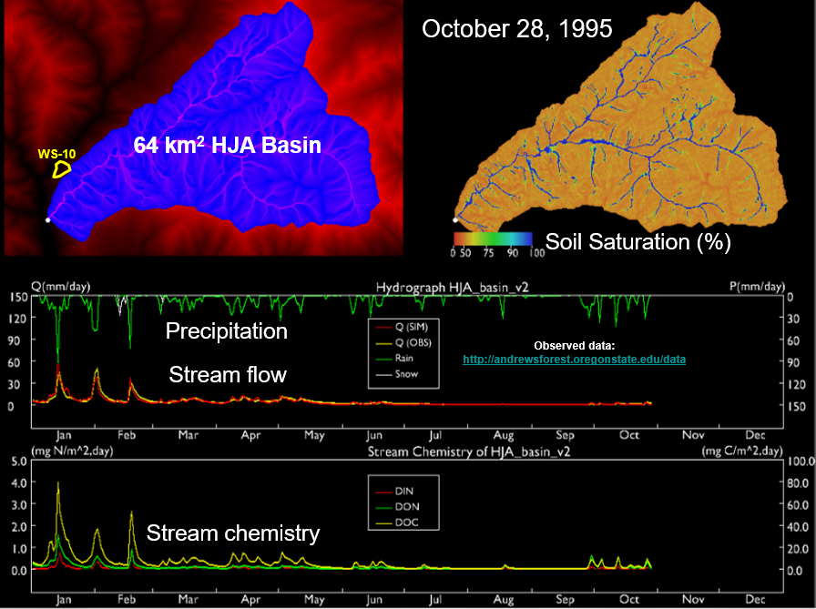
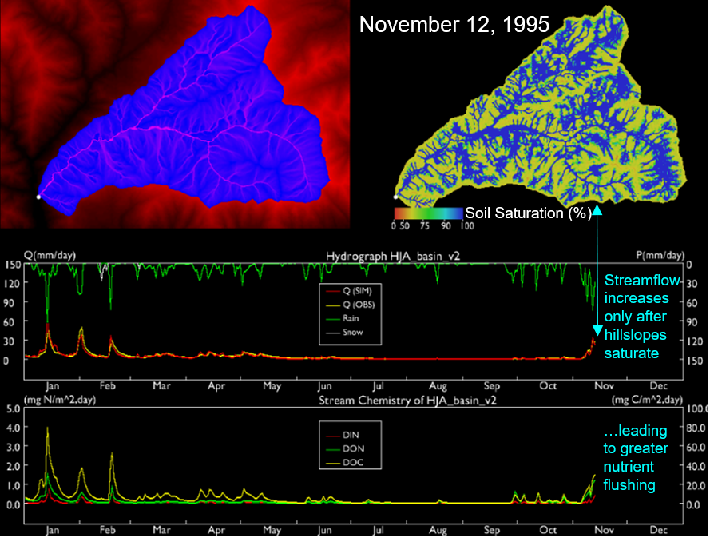

Puget Sound Projects
VELMA Overview
Basin-Scale Nutrient Remediation
Urban Stormwater GI
R2R2R Community Benefits
SSWR Project 5.2.2
Puget Sound Basin-Scale Nutrient Remediation
VELMA Results Illustrate How Hillslope Hydrologic Connectivity Controls Stream Flow and Nutrient Loads
page 2 of 2
Nutrient loads to streams are highly sensitive hydrologic connectivity along hillslopes. In this October 28th scene, dry season hillslopes (upper right frame) are hydrologically disconnected, such that initial fall rains are insufficient to saturate hillslopes and activate transport of water (middle frame) and soil nutrients to streams (lower frame).
page 1 of 2
In this November 12th scene, the first major precipitation event of the wet season (green line in middle frame) results in extensive soil saturation along hillslopes, triggering hydrologic connectivity (blue zones, upper right) and the first significant flush of water and nutrients to the stream (spikes in middle and lower frames)
Methods – N Loads & Hydrologic Connectivity
HJ Andrews Forest, Oregon - 64 km²
Stream nutrient loads are seasonally variable and highly sensitive to storm events that flush nutrients and contaminants from hillslopes to streams.
VELMA captures this spatial and temporal variability by simulating how hillslope hydrological connectivity (degree of saturation) controls flushing of nutrients from any source along hillslopes.
The two frames at right for October 28 and November 12 illustrate how VELMA captures this well-established nutrient flushing mechanism. (Stieglitz et al. (2003) describe the underlying principals: https://agupubs.onlinelibrary.wiley.com/doi/full/10.1029/2003GB002041).
The timing of hillslope flushing of pollutants is a threat to salmon returning to spawn in Puget Sound watersheds and to the marine food web.
Note: In Slide Show View, click on the slide to reveal the frame for November 12 (page 2 of 2), when fall rains activate hillslope flushing of nitrate.
Saturated Hillslopes
Unsaturated Hillslopes

Slide 28
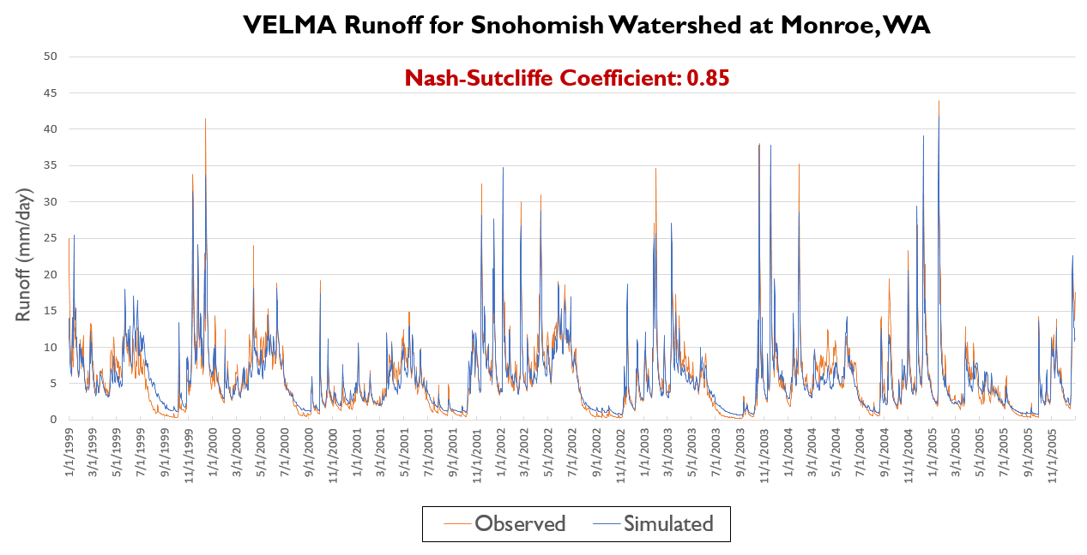
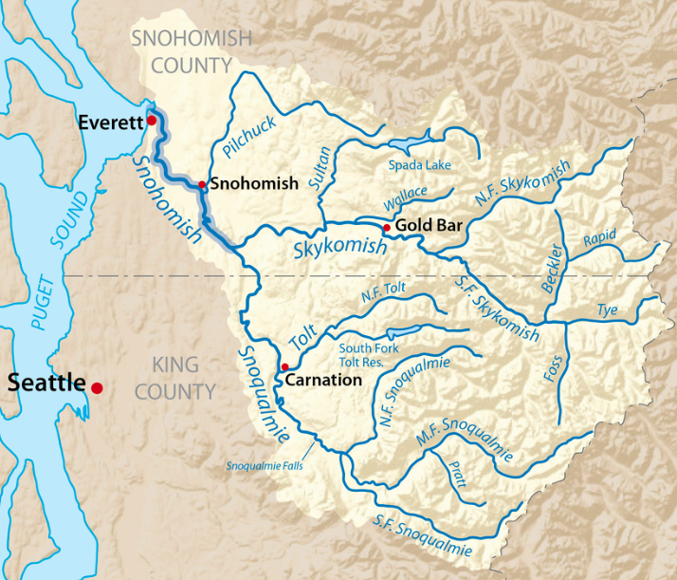
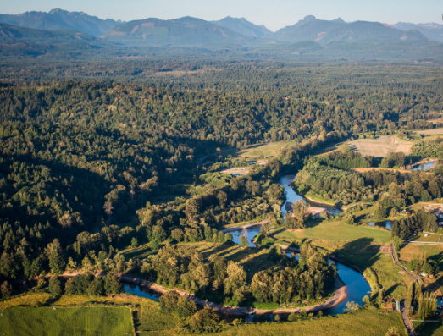
Puget Sound Projects
VELMA Overview
Basin-Scale Nutrient Remediation
Urban Stormwater GI
R2R2R Community Benefits
SSWR Project 5.2.2
Puget Sound Basin-Scale Nutrient Remediation
VELMA Runoff for Snohomish Basin at Monroe, WA
Methods – Scaling Up, Catchments to Basins
Due to hillslope flushing dynamics, accurate simulation of nutrient loads and runoff go hand in hand. VELMA uses parallel processing of small catchments to efficiently and accurately model peak and low flows in large Puget Sound basins, such as the 1,856 sq mi Snohomish River basin.
The excellent fit between simulated and observed peak and low flows (right) reflects combined effects land use (ag, forestry, etc.) and rain/snow dynamics across elevation gradients.
VELMA also simulates effects of forest stand age on summer low flows. Paired catchment studies of young and old forest show that young plantation forests transpire more water than mature forests, reducing summer low flows by about half.
Note: details on VELMA applications and empirical studies addressing low flow responses can be found here (slides included).
Snohomish Basin 1,856 km²
washingtonnature.org

Slide 29

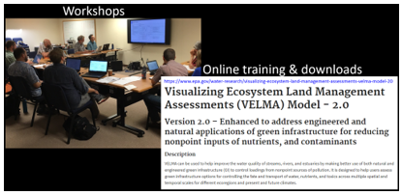
Puget Sound Projects
VELMA Overview
Basin-Scale Nutrient Remediation
Urban Stormwater GI
R2R2R Community Benefits
SSWR Project 5.2.2
Puget Sound Basin-Scale Nutrient Remediation
Project Partners per Puget Sound Partnership NTA 2018-0721
University of WA Tacoma Puget Sound Institute
US EPA/ORD/CPHEA/PESD, Corvallis, OR
Pacific Northwest National Laboratory
NOAA Pacific Northwest Fisheries Science Center
WA Department of Ecology
Local Integrating Organizations (LIOs)
Tribes: Nisqually, Snoqualmie, Tulalip…
WA counties: King, Thurston…
Cities: Seattle, Burien…
Community Forest organizations
Project Partnership Plan: PSP Near Term Action Proposal (NTA 2018-0721)
NTA Title: Engagement of state and local governments in basin-scale Puget Sound modeling and restoration (per Basin-Scale Nutrient Remediation Project)
Objectives: Collaborate with local and state restoration planners to build their ecosystem restoration plans into a linked terrestrial-marine model of Puget Sound, to help community and regional restoration planners visualize local and downstream benefits for salmon, water quality/quantity, and other ecosystem services.
Description: Local restoration planners face the difficult challenge of extrapolating impacts of restoration actions over time and space. Similarly, modelers attempting to extrapolate long-term impacts of human activities on the Puget Sound ecosystem often lack detailed knowledge of local stressors & remediation plans.
This NTA seeks to bring together restoration local and state planners & modelers to build model scenarios based on actual ecosystem management plans.
The model ensemble team (VELMA/Salish Sea Model/Atlantis) will apply the planner’s scenarios to support local and regional Puget Sound restoration planning goals (as described herein).
Modeled restoration targets will include high priority Puget Sound Recovery Goals and Vital Signs described herein.
The Puget Sound Institute will facilitate planner-modeler workshops to help local and state planners play out benefits & tradeoffs for their restoration choices.

Slide 30
Puget Sound Projects
VELMA Overview
Basin-Scale Nutrient Remediation
Urban Stormwater GI
R2R2R Community Benefits
End
Basin-Scale Nutrient Remediation (SSWR 5.2.2)
Begin
Urban Stormwater Green Infrastructure (SSWR 10.1.1)

Slide 31
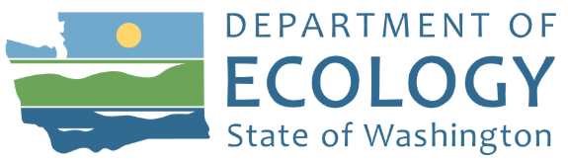
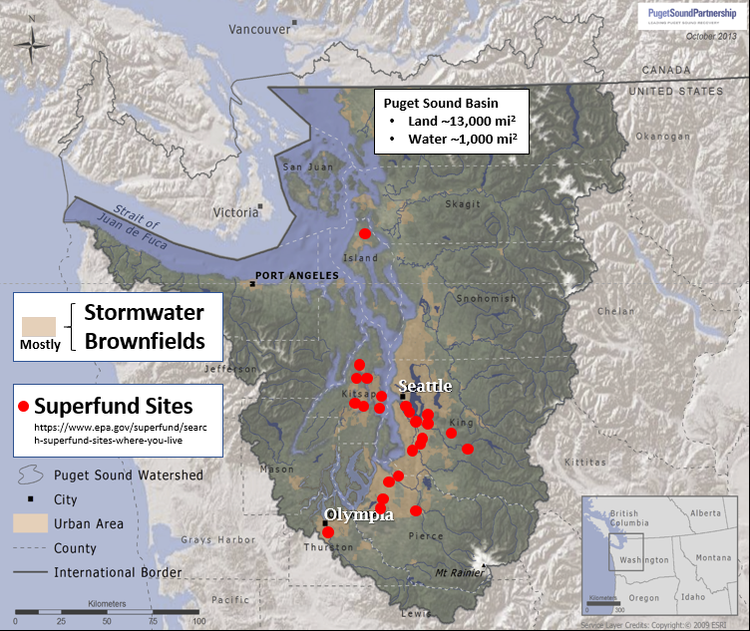
Puget Sound Projects
VELMA Overview
Basin-Scale Nutrient Remediation
Urban Stormwater GI
R2R2R Community Benefits
Region 10 RARE + SHC Project 10.1.1
“VELMA Modeling for Salmonid and Orca Recovery in Puget Sound” + “Green and gray infrastructure to manage stormwater quantity and quality”
“The most common delivery pathway toxic chemicals take to reach Puget Sound is through polluted surface runoff — also known as stormwater. Rain hits roofs, roads, developed areas, and other hard surfaces and runs into storm drains. It then goes mostly untreated into lakes, streams, and rivers that drain to Puget Sound.”
Reference link
Goal: Use VELMA to address high priority science and decision support questions facing community, state, tribal and federal stakeholders:
What are the main sources and biophysical factors controlling fate and transport of toxics in stormwater draining from Puget Sound near-shore communities?
To what extent can proposed brownfield cleanup and green infrastructure solutions - such as rain gardens, bioswales, pervious pavements, green roofs, riparian buffers - reduce loadings of toxics in urban stormwater and streams draining into Puget Sound?
What are the implications of modeled reductions in stormwater toxics for salmonids and orcas?

Slide 32
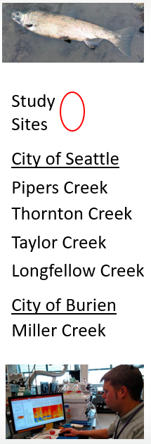
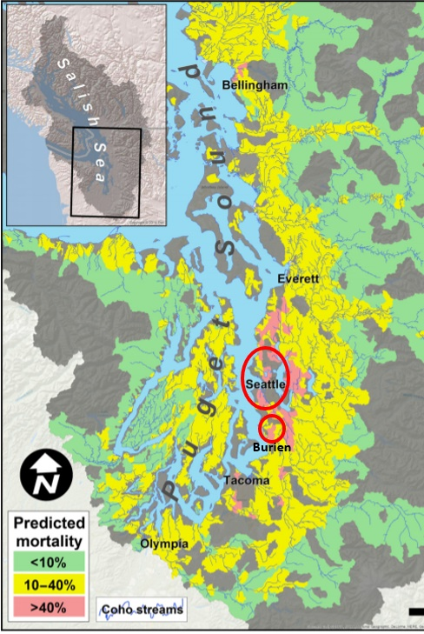
Puget Sound Projects
VELMA Overview
Basin-Scale Nutrient Remediation
Urban Stormwater GI
R2R2R Community Benefits
Region 10 RARE + SHC Project 10.1.1
“VELMA Modeling for Salmonid and Orca Recovery in Puget Sound” + “Green and gray infrastructure to manage stormwater quantity and quality”
Coho
Study
Sites
City of Seattle
Pipers Creek
Thornton Creek
Taylor Creek
Longfellow Creek
City of Burien
Miller Creek
Modeling Challenges
Synthesis of supporting biophysical, ecotoxicological and civil engineering data describing stormwater contaminant loads and management methods in Puget Sound nearshore communities
Quantify effectiveness of green infrastructure (GI) for reducing stormwater contaminant loads and impacts on aquatic species and human health
Strategy for Addressing Challenges
Apply VELMA and Aquatox in collaboration with Puget Sound stormwater scientists and managers to model contaminant fate and transport in selected nearshore community “hotspots” (see inset, right)
Near-term Goal
VELMA urban GI demonstration for the Miller Creek watershed in the City of Burien, WA, site of high urban contaminant loads (link) and high coho salmon mortality
Feist et al. 2018

Slide 33
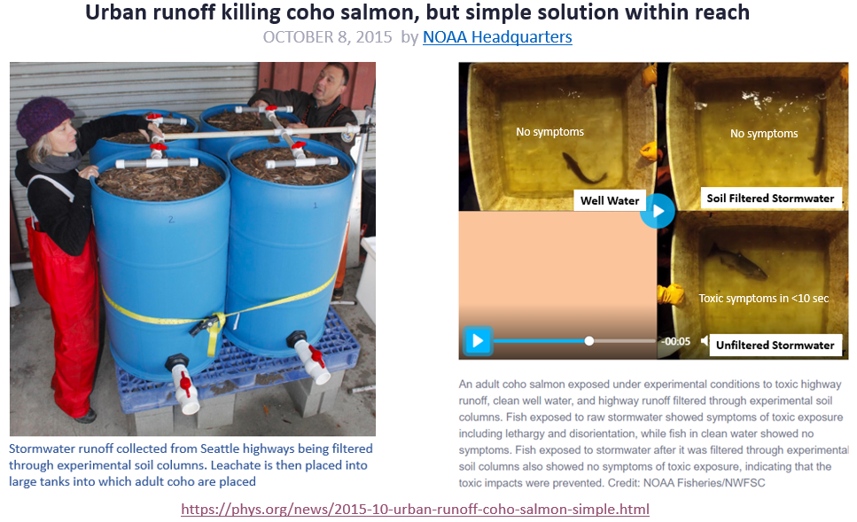
Puget Sound Projects
VELMA Overview
Basin-Scale Nutrient Remediation
Urban Stormwater GI
R2R2R Community Benefits
A key demonstration of the effectiveness of green infrastructure treatments,
such as rain gardens, bioswales, riparian buffers, pervious pavements…

Slide 34
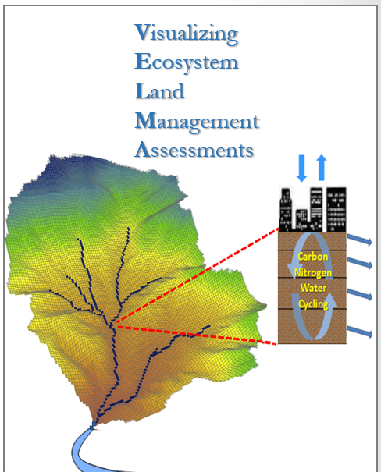
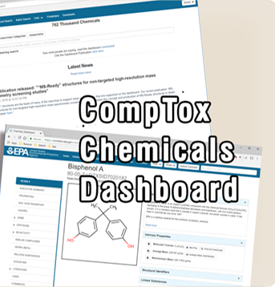
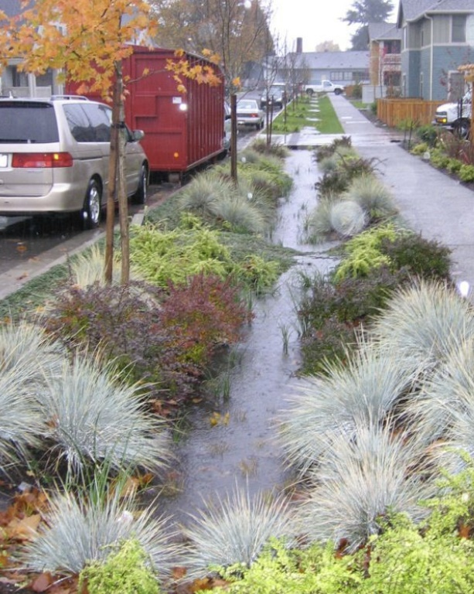
Puget Sound Projects
VELMA Overview
Basin-Scale Nutrient Remediation
Urban Stormwater GI
R2R2R Community Benefits
VELMA v2.1 Watershed Simulator to Address Contaminant Fate and Transport
Purpose:
Estimate contaminant fate and transport in urban & rural watersheds → Organics (PCB, PAH, PFAS, Pesticides, etc.), Heavy Metals (Mercury…), Nutrients
Results:
Inform options for reducing toxic chemical in stormwater via engineered & green infrastructure solutions.
Expected Use:
Support Clean Water Act, CERCLA, National Pollutant Discharge Elimination System, Endangered Species Act, H.R.4266-Clean Water Through Green Infrastructure Act
VELMA v2.1 includes open source software, user manual and demos quantifying contaminant fate and transport & mitigation strategies
34
Notes:
Though not originally built to model urban watersheds, VELMA’s framework is well suited due to how the model implements the fate and transport of chemicals via water movement.
Leveraging information obtained in the CompTox database, contaminant movement and remediation can be simulated within a spatially explicit context.

Slide 35
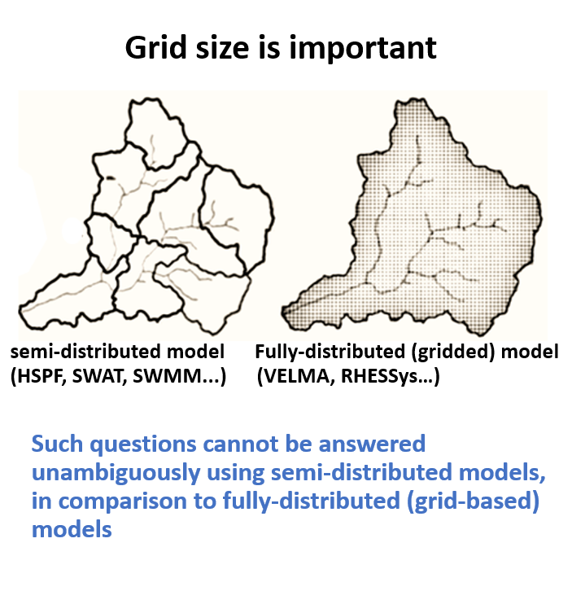
Why VELMA? Visualizing Ecosystem Land Management Assessments
Puget Sound Projects
VELMA Overview
Basin-Scale Nutrient Remediation
Urban Stormwater GI
R2R2R Community Benefits
Grid size is important
Image: Mahmoud Saleh Al-Khafaji
Urban applications require object representation
Small grid cells spatially address effects of impervious surfaces, curbs, drains, pipes, rain gardens, green roofs, and other gray and green infrastructure.
Urban stormwater questions:
Where and what types of gray and green infrastructure should stormwater managers use to reduce stormwater runoff and contaminant loads to streams and estuaries?
35
Notes:
Why is a gridded model important? The grid cells allow for explicit representation of both the water flow pathways and placement of green infrastructure along those pathways. VELMA’s fate and transport framework allows for simulation of contanimant movement and remediation per cell. Such a framework allows stormwater managers to test various types of green infrastructure and obtain an understanding of contaminant reductions

Slide 36







VELMA contaminant modeling demo
Puget Sound National Estuary
Dominant flow paths
Blue = most flow
Watershed boundary
3-D display
Dominant flow paths
Blue = most flow
Outlet
(sea level)
Watershed boundary
131 m
above sea level
2019 VELMA Contaminant Progress
>99% of initial PCB remains at spill site afer 597 days
36
Notes:
VELMA progression, 2019 work on how contaminants work through the soil matrix.
Appropriate regarding the seepage of chemicals into the soil, no pipes n drains
Persistent organic pollutants persist within the environment for years, continuing to do damage.

Slide 37



Puget Sound Projects
VELMA Overview
Basin-Scale Nutrient Remediation
Urban Stormwater GI
R2R2R Community Benefits
Region 10 RARE + SHC Project 10.1.1
“VELMA Modeling for Salmonid and Orca Recovery in Puget Sound” + “Green and gray infrastructure to manage stormwater quantity and quality”
Miller Creek Watershed showing gray infrastructure and CUW water quality sampling
Miller Creek Watershed (Burien, WA)
Modeling effects of gray and green infrastructure
We are using data-rich Miller Creek watershed in the City of Burien to examine the effects of gray and green infrastructure on stormwater runoff and contaminant loads to Miller Creek
Gray infrastructure includes impervious surfaces (roads networks, roofs, drains and stormwater pipes)
Green infrastructure includes pervious roads, green roofs, rain gardens, riparian buffers and similar installations designed to store, infiltrate, or evapo-transpire to reduce stormwater flows and contaminant loads to combined sewer systems and surface waters
Water quality data provided by University of WA Center for Urban Waters (CUW) → VELMA calibration/validation
CUW’s stormwater and stream contaminant sampling data for Miller Creek provide insight into temporal patterns of contaminant fate and transport and potential sources within the watershed (Peter et al. 2020)
Current 2020 VELMA Contaminant Work

Slide 38




Puget Sound Projects
VELMA Overview
Basin-Scale Nutrient Remediation
Urban Stormwater GI
R2R2R Community Benefits
Near-Term and Longer-Range Puget Sound Modeling Priorities
VELMA
Freshwater
Toxics, Nutrients
Marine Nutrients, Toxics, Dissolved O₂
Marine Food Web, Toxics in Fish

Slide 39
Puget Sound Projects
VELMA Overview
Basin-Scale Nutrient Remediation
Urban Stormwater GI
R2R2R Community Benefits
End
Urban Stormwater Green Infrastructure (Region 10 RARE, SSWR 10.1.1)
Begin
R2R2R Community Benefits (SHC 9.3.5)

Slide 40

Puget Sound Projects
VELMA Overview
Basin-Scale Nutrient Remediation
Urban Stormwater GI
R2R2R Community Benefits
SHC Project 9.3.5 (FY20-22)
Where to work? Development of remediation and restoration strategies to revitalize community health and well-being in contrasting urban-estuarine ecosystems
Puget Sound
McKane et al.
Great Lakes
Hoffman et al.
Goal: use contrasting urban-estuarine ecosystems to broadly demonstrate watershed-scale strategies for determining where and how to implement contaminated site remediation and restoration practices to revitalize (R2R2R) community land-water assets and human health and well-being.
Demonstration sites: contaminant and health-impacted communities across three estuaries of national concern –
Great Lakes communities
Puget Sound communities
San Juan Bay, Puerto Rico
San Juan Bay
Oczkowski et al.

Slide 41

Puget Sound Projects
VELMA Overview
Basin-Scale Nutrient Remediation
Urban Stormwater GI
R2R2R Community Benefits
SHC Project 9.3.5
Puget Sound R2R2R Demonstration Site
Challenges
Local, state, tribal and federal partners need tools & information for reducing contaminant loads in urban stormwater draining to streams and Puget Sound
Quantify link between ecological condition (toxics in fish) and human health
Strategy for addressing challenges
Use ORD’s VELMA and Aquatox models to identify green and gray infrastructure best practices for stormwater cleanup
Provide partners practical science-based guidance for implementing stormwater GI
Near-term goals
Develop VELMA GI modeling demos for Seattle area communities and partners
Begin partner/community outreach workshops using structured decision making using DASEES (with B. Dyson and T. Canfield)

Slide 42
Contact Info
Bob McKane, PhD
Research Ecologist
US EPA Office of Research and Development
Center for Public Health and Environmental Assessment
Pacific Ecological Systems Division
200 SW 35th St.
Corvallis, OR 97333
mckane.bob@epa.gov

